Slide 1
Sample_superstore_sales_products Data Viz. using Tableau
File created on: 1/5/2023 8:58:21 PM

Slide 2
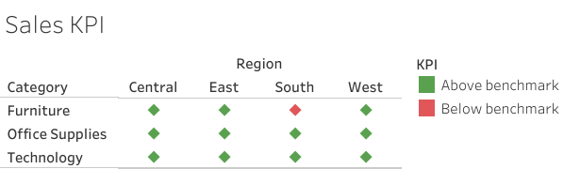

Slide 3
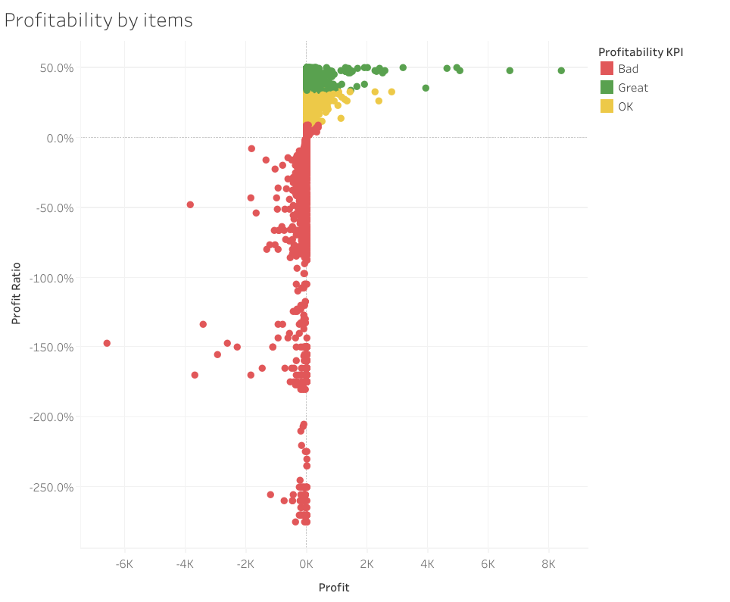

Slide 4
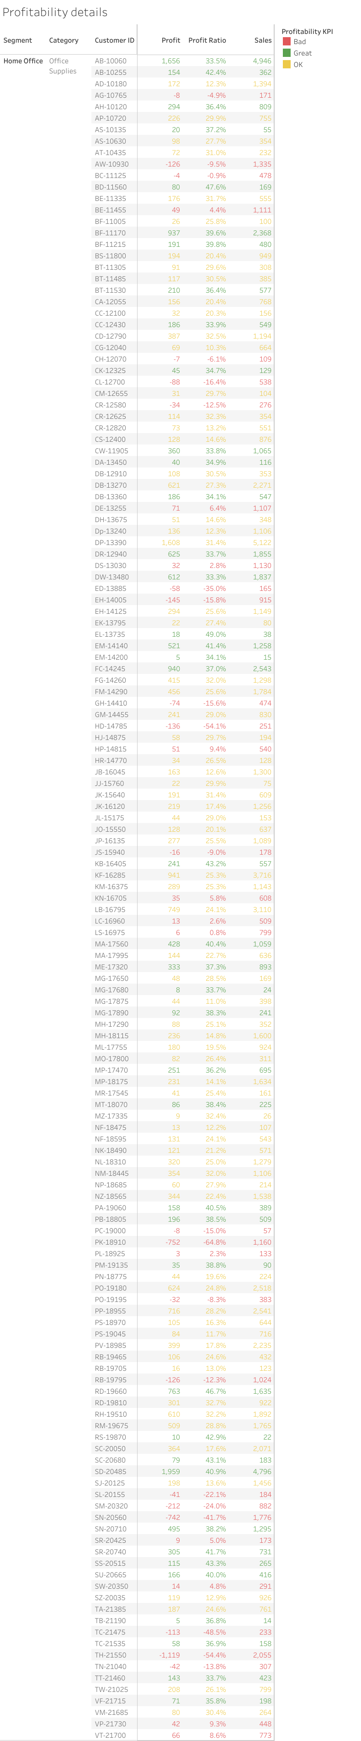

Slide 5
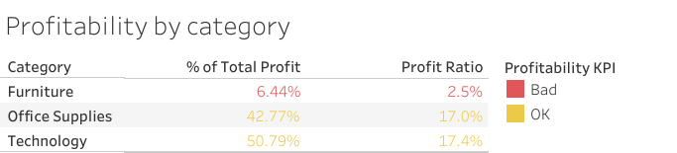

Slide 6
